Slide 1
FIRE SECURITY SYSTEM
Prabhuram s s
Vignesh u k
Naveen r s
1st year ECE

Slide 2
Fire security system
A fire alarm system has a number of devices working together to detect and warn people through visual and audio applications when smoke , fire, carbon-mono-oxide or other emergencies are present
These alarms may be activated automatically from smoke detectors and heat detectors or activated manually.
Alarms can be either motorized bells, wall mounted horns, sms alert sender etc…

Slide 3
Needs for Fire security system
Fire Alarm system are very useful in remote locations where human interaction is limited. Such systems are useful in mines, industrial areas, factories etc.
Fire Alarm system helps to monitor locations and alert during fire that occurs in night time.
Fire Alarm system helps to monitor locations and alert during fire that occurs in night time. Fire Alarm system helps to monitor locations and alert during fire that occurs in night time and hence remedy actions can be taken quickly. This helps to prevent major damages and losses created by a fire accident.

Slide 4
Abstract:
The main objective of this project is to develop a fire security system using an arduino board. as Technologies are emerging rapidly in the modern world, they must be utilized wisely to protect our surroundings from fire loss.
Aim:
The aim of the project is to design and construct a fire alarm that will sence the presence of fire and alerts the surrounding.

Slide 5
Components required
Arduino uno
Jumper wires
Bread board
Lm 35 thermistor
Buzzer
Lcd display
Resistors
Gsm module
Potentiometer

Slide 6
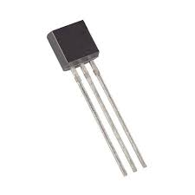
Temperature sensor
Lm 35 thermistor is used to measure the environmental temperature.
Its resistance varies with respect to temperature
Here we have used Thermistor to read the temperature.
We already interfaced Thermistor with Arduino.

Slide 7
Temperature sensor
Lm 35 thermistor is used to measure the environmental temperature.
Its resistance varies with respect to temperature
Here we have used Thermistor to read the temperature.
We already interfaced Thermistor with Arduino.

Slide 8
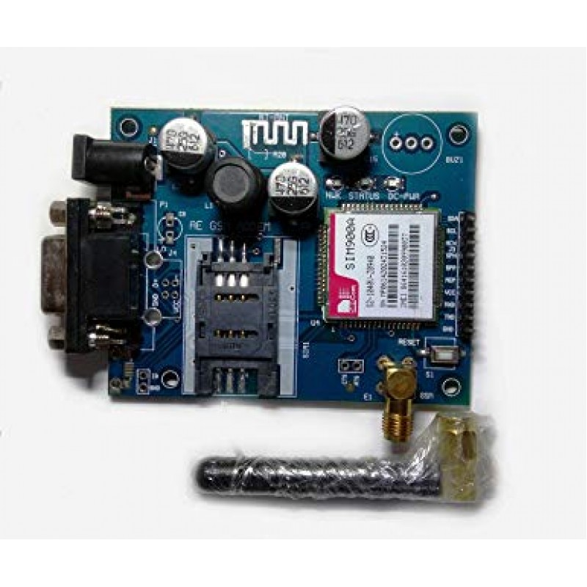
Gsm module
GSM-GLOBAL SYSTEM FOR MOBILE COMMUNICATION
It is a chip which is used to establish communication between mobile devices or a computing machine
HERE WE HAVE ATTACHED GSM TO SEND ALERT MESSAGE TO THE AUTHORITY INCHARGE OR THE OWNER

Slide 9
Gsm module
GSM-GLOBAL SYSTEM FOR MOBILE COMMUNICATION
It is a chip which is used to establish communication between mobile devices or a computing machine
HERE WE HAVE ATTACHED GSM TO SEND ALERT MESSAGE TO THE AUTHORITY INCHARGE OR THE OWNER

Slide 10
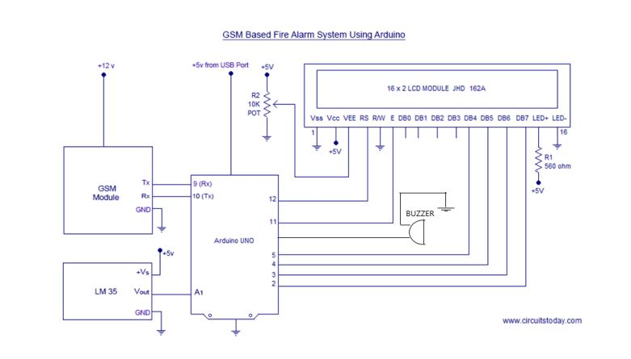
CIRCUIT DIAGRAM

Slide 11
CIRCUIT DIAGRAM

Slide 12
CONCLUTION
THUS THE FIRE SECURITY SYSTEM HAS BEEN DESIGNED AND CONSTRUCTED SUCCESFULLY, AND IS ALSO PROVED TO WORK IN A THE EXPECTED MANNER.
REFERENCE
http://www.circuitstoday.com/
https://circuitdigest.com/

Slide 13
THANK YOU

